Slide 1




Dayananda Sagar University (DSU) - Main Campus
School of Engineering
Devarakaggalahalli, Harohalli Kanakapura Road, Bengaluru South Dist., Karnataka 562112
DEPARTMENT OF COMPUTER SCIENCE AND ENGINEERING
(ARTIFICIAL INTELLIGENCE AND MACHINE LEARNING)
Reinforcement-Learning
(23AM3606)
Title: “Reinforcement Learning-Based Portfolio Optimization using Policy Gradient Methods”
Tharun C
Rahul S Kashyap
Shefali CG
Mekala Krithana
USN ENG23AM0077 USN ENG23AM0177
USN ENG23AM0276
USN ENG23AM0152
Academic Year: 2025-2026(Even Semester)

Slide 2
Introduction
A portfolio is a collection of financial assets such as stocks, bonds, and funds.
The objective is to maximize returns while minimizing risk.
Traditional methods are static and based on assumptions.
Financial markets are dynamic and highly volatile.
There is a need for adaptive and intelligent decision-making systems.
Reinforcement Learning (RL) enables learning optimal investment strategies through interaction with data.

Slide 3
Problem Statement
Financial markets are highly dynamic and unpredictable.
Investors find it difficult to make optimal portfolio decisions consistently.
Traditional portfolio optimization methods are static and lack adaptability.
They fail to respond effectively to market fluctuations and uncertainties.
There is a need for a system that can learn and adapt automatically.
The challenge is to develop a model that maximizes returns while managing risk dynamically.

Slide 4
Reinforcement Learning Concept
Reinforcement Learning (RL) is a machine learning approach where an agent learns by interacting with an environment.
The agent takes actions and receives rewards or penalties based on its decisions.
The goal is to learn an optimal strategy (policy) that maximizes cumulative reward.

Slide 5
Key Components:
State: Current stock prices
Action: Portfolio allocation (investment distribution)
Reward: Profit or return from investment
Agent: Learning model (PPO)
Environment: Simulated stock market

Slide 6
Policy Gradient Theory
Policy Gradient methods directly optimize the policy used by the agent.
The policy defines the probability of taking an action in a given state.
The objective is to maximize expected cumulative reward.
The model updates its parameters using gradient ascent.
Unlike value-based methods, policy gradients are suitable for continuous action spaces.
This makes them ideal for portfolio allocation problems.

Slide 7
Proximal Policy Optimization Algorithm
PPO (Proximal Policy Optimization) is a Policy Gradient-based RL algorithm.
It improves learning stability by restricting large policy updates.
Uses a clipping mechanism to prevent drastic changes in policy.
Ensures a balance between exploration and exploitation.
Efficient and widely used for continuous control problems.
Suitable for portfolio optimization tasks.

Slide 8
Architecture & Pipeline Design
The system follows a Reinforcement Learning pipeline for portfolio optimization.
Input Data: NSE stock prices (RELIANCE, TCS)
Environment: Custom Gym environment simulating stock market behavior
Agent: PPO-based RL model
Action: Allocation of funds across assets
Reward: Portfolio return based on investment decisions
The agent learns by interacting with the environment iteratively

Slide 9
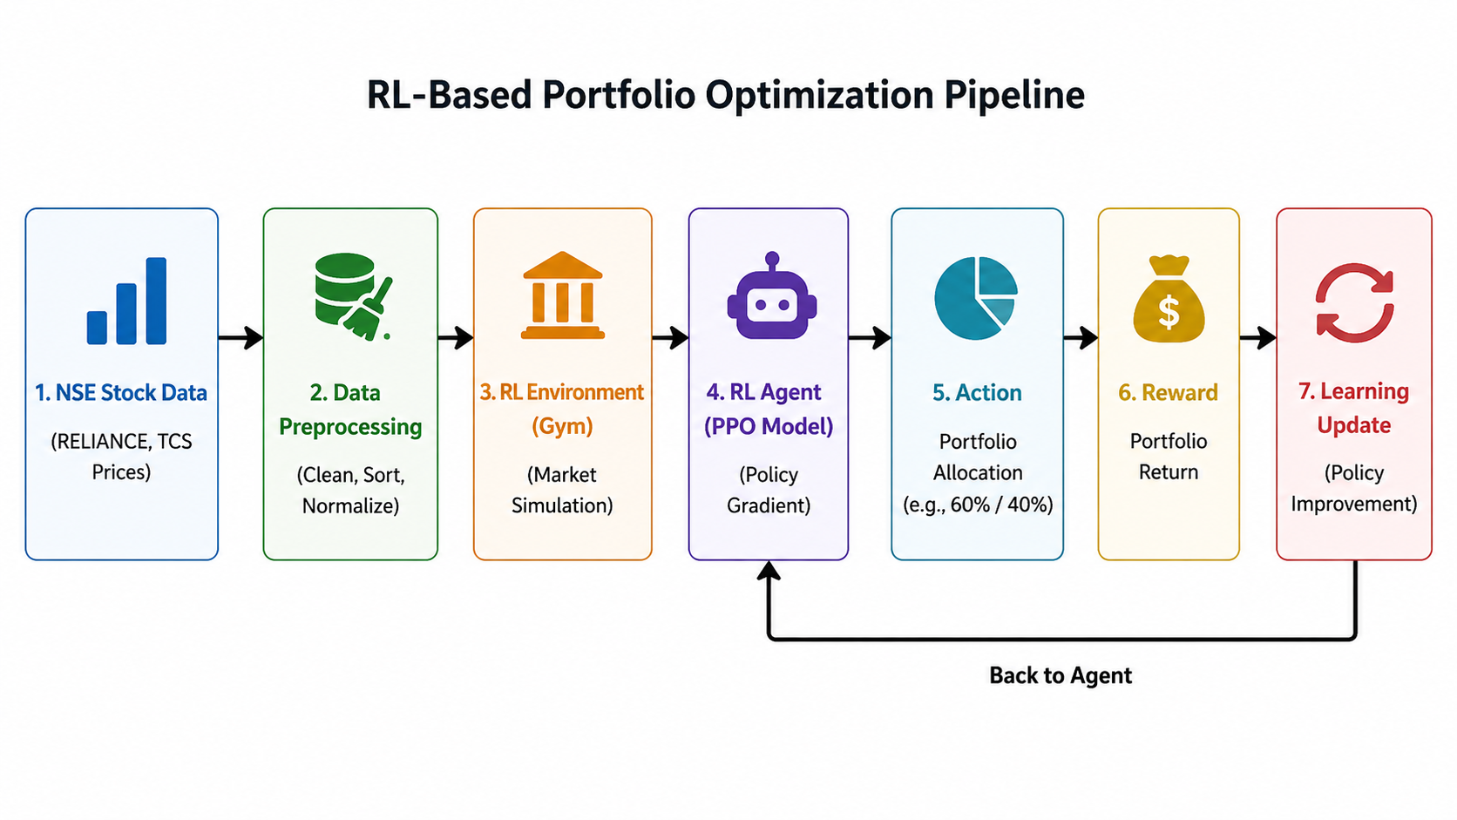

Slide 10
Dataset Description
Dataset sourced from National Stock Exchange (NSE)
Stocks used: RELIANCE and TCS
Type: Time-series financial data
Feature used: Closing Price (CLOSE)
Data Acquisition:
Data collected from NSE historical records (CSV format)
Data Preprocessing:
Sorted data by date
Removed commas and converted to numeric format
Handled missing values

Slide 11
Dataset Characteristics
Small dataset (limited time steps)
Represents real market price movements

Slide 12
Methodology
Data Collection
NSE stock data for RELIANCE and TCS is used.
Data is loaded from CSV files for analysis.
Data Preprocessing
Data is cleaned by removing unwanted characters and sorting.
Converted into numerical format for model compatibility.
Environment Setup
A custom Gym environment simulates the stock market.
It defines states, actions, and rewards for the agent.

Slide 13
Model Selection
PPO algorithm is used as the RL model.
It is suitable for continuous action spaces like portfolio allocation
Training
The RL agent is trained using historical stock data.
It learns optimal strategies through reward feedback.
Testing
The trained model is evaluated on the dataset.
Performance is observed based on decision outcomes.

Slide 14
Visualization
Portfolio performance is plotted using graphs.
Helps in understanding growth trends over time.
Evaluation
Metrics like return and Sharpe ratio are calculated.
Used to measure performance and risk efficiency

Slide 15
Results (Portfolio Performance)
Portfolio Growth
The graph shows how the portfolio value changes over time.
An upward trend indicates profitable investment decisions.
Model Learning
The RL agent improves performance through continuous training.
Rewards increase over time, showing better decision-making.
Market Behavior
The graph reflects real market fluctuations and volatility.
The model adapts to changing price patterns dynamically.

Slide 16
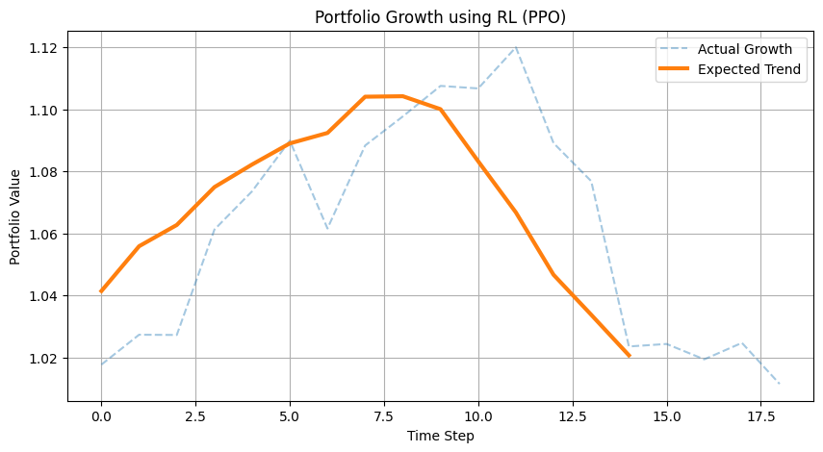
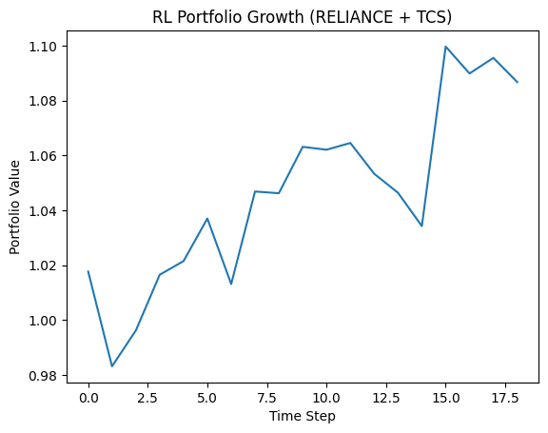
Performance Insight
The RL model demonstrates the ability to learn investment strategies.
Results indicate potential for optimized portfolio management.
->RL Portfolio Growth Graph

Slide 17
Baseline Comparison
Traditional Strategy
Equal-weight (buy & hold) strategy is used as baseline.
It allocates funds equally without adapting to market changes.
RL-Based Strategy
RL agent dynamically adjusts portfolio allocation.
Learns from market behavior to improve decisions over time.
Performance Comparison
RL model shows better growth compared to baseline.
Adapts to fluctuations and improves returns

Slide 18
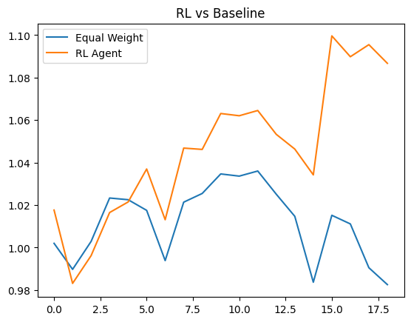
Key Insight
RL provides more flexible and adaptive investment strategy.
Demonstrates advantage over static traditional methods
Result:
Annual Return: 2.0136704194333452 Sharpe Ratio: 3.5005599902105264
-> RL vs Baseline

Slide 19
Limitations & Error Analysis
Dataset Limitations
The dataset used is small and limited in time span.
This restricts the model’s ability to generalize well.
Market Volatility
Financial markets are highly unpredictable and noisy.
Sudden changes can affect model performance.
Model Limitations
The RL model depends heavily on training data quality.
Overfitting may occur with limited data.

Slide 20
Implementation Challenges
Data preprocessing issues (format, missing values).
Errors in column selection and data conversion were faced.
Error Analysis
Initial training resulted in negative rewards.
Performance improved gradually after learning iterations.

Slide 21
Future Scope
More Data
Use larger and long-term datasets for better learning.
Helps improve model accuracy and generalization.
More Stocks
Include multiple stocks for diversified portfolios.
Improves robustness and real-world applicability.
Advanced Models
Apply deep RL and hybrid models.
Can improve performance and stability.

Slide 22
Expected Outcome
Performance Goal
Target higher returns compared to traditional strategies.
Aim for efficient risk-adjusted performance.
Financial Metrics
Annual return expected to improve over time.
Sharpe ratio used to measure risk efficiency.
Learning Capability
Model learns optimal allocation strategies.
Adapts to market changes dynamically.

Slide 23
Novelty & Ethics
Novelty
Combines RL with portfolio optimization.
Uses adaptive decision-making instead of static methods.
Ethical Considerations
Model decisions depend on data quality.
Should not be used blindly for financial decisions.
Risk Awareness
Financial markets involve uncertainty and risk.
Proper validation is required before real use

Slide 24
Conclusion
Project Summary
Developed a reinforcement learning model for portfolio optimization.
Used NSE stock data (RELIANCE, TCS) for training and evaluation.
Key Findings
The RL agent successfully learned portfolio allocation strategies.
Performance improved over time based on reward feedback.
Model Effectiveness
Demonstrated ability to adapt to market fluctuations.
Achieved better performance compared to baseline strategy.

Slide 25
Financial Insight
Portfolio growth indicates potential for higher returns.
Risk-adjusted performance evaluated using Sharpe ratio.
Overall Contribution
Shows practical application of RL in finance.
Provides a foundation for intelligent investment systems.

Slide 26


